Slide 1
Product Proposal
GT Bill

Slide 2


The Problem
Digital Consumers
Multi-service Operators
Is developing deeper relationships with modern consumer companies
More often cross-sold by companies like Apple than traditional players like banks, telecos, and utility companies
Faces slipping margins and fierce competition
Regulatory changes pinching core business lines
Inability to introduce net new services seamlessly
Notes:
While there are many digital crypto wallets around today, very few have successfully driving adoption among retailers and restaurants, which itself has inhibit the growth of crypto revenue and legitimacy.
These physical establishments face slipping margins as the shift to a cashless society drives credit card fees ever higher while competition from digital channels makes capturing consumer interest harder and repeat business harder still — and those high barriers to entry in the business prevent smaller business owners, freelancers, and service people from benefitting at all.

Slide 3





Our Solution
GT Bill is the only consumer-first business operations platform.
Multi-service operators that adopt GT Bill can provide consumers with a seamless and cohesive experience for sales, billing, support, and consumption of their services.
No more clunky legacy systems and janky user experiences; just one portal, one bill, and one relationship.
Notes:
Project “GT Wallet” will allow consumers to use (digital) fiat currency, cryptocurrency, or on-demand financing to pay at restaurant or retail locations while earning incentives from those venues to return.
GT Wallet will allow retailers and restaurateurs to accept crypto and receive fiat while enjoying lower processing fees and a low-cost increase in demand driven through the integrated loyalty program.
The GT Wallet will be app #1 for the “GT Commerce Cloud” platform, which will facilitate expansion into adjacent e-commerce and payment spaces, including P2P payments, auctioning, and more in the future.

Slide 4



Strategic Fit
Flexiti
JVs
Multi-service Commerce
Crypto Payments
Smart Energy Trading
Tech
Blockchain
Machine Learning
IoT
Notes:
Flexiti JV
FutureVault JV
Coinsquare JV?
Coinsquare Wallet
Blockchain angle / how does this fit our tech mandate?
Mid-term: Loyalty against purchase history
Long-term: Purchase asset on the asset chain to facilitate safe auction experiences

Slide 5
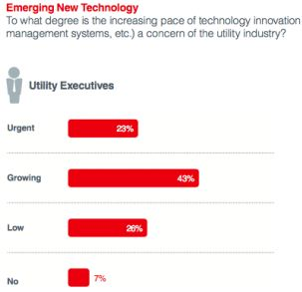
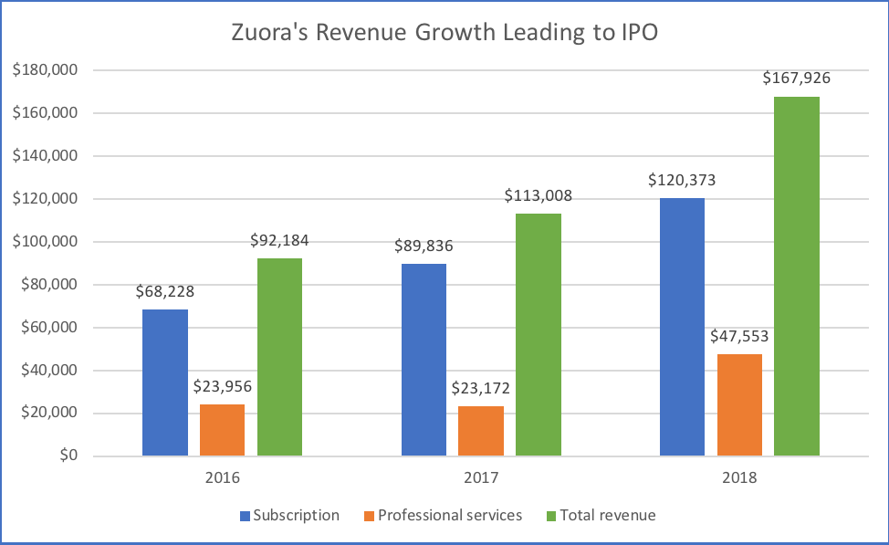
Why Now?
https://www.opexengine.com/zuora-powering-the-subscription-revenue-economy-with-43-ipo-based-on-operating-metrics/ https://www.greentechmedia.com/articles/read/seven-charts-that-show-utility-priorities-for-2015-and-beyond

Slide 6
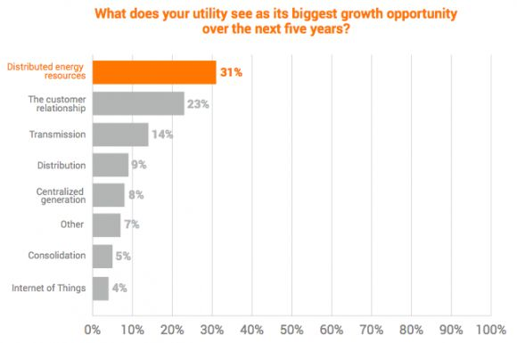
Why Now?
https://www.opexengine.com/zuora-powering-the-subscription-revenue-economy-with-43-ipo-based-on-operating-metrics/ https://www.greentechmedia.com/articles/read/seven-charts-that-show-utility-priorities-for-2015-and-beyond

Slide 7
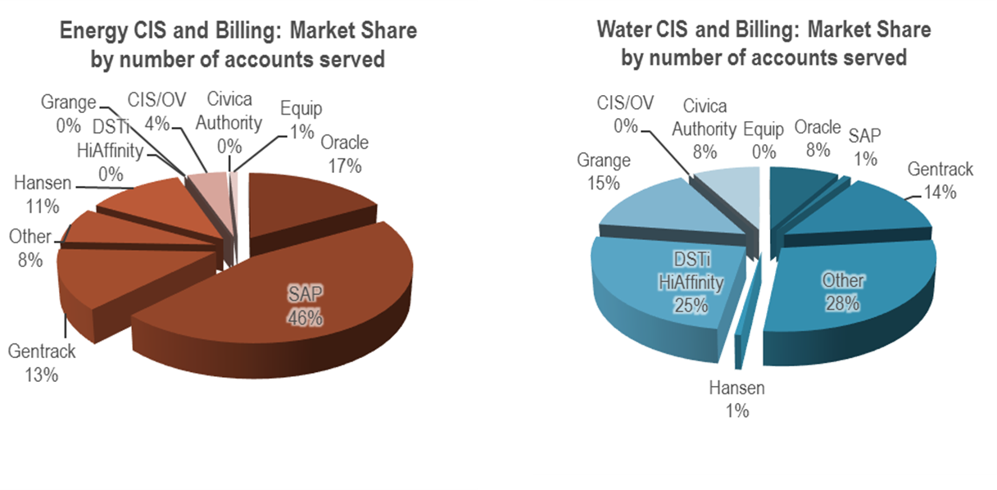
Market Sizing
$100B
(Subscription tools market by 2020)
$61B
(Utility CIS market by 2027)
https://www.zuora.com/press-release/new-report-reveals-subscription-economy-tools-market-reaching-100-billion-through-2020/
https://www.navigantresearch.com/newsroom/the-global-market-for-utility-customer-information-and-relationship-management-systems-is-expected-to-total-61-1-billion-over-the-next-decade
http://www.marchmenthill.com/qsi-online/2012-11-01/smarter-systems-procurement-understanding-cis-billing-systems-market-gives-water-businesses-investment-head-start/

Slide 8














Competition
Generic
Customer Information System
Billing
Sector-Specific

Slide 9



Our Product
GT Bill
GT Provision
Customer Management
Products & Pricing
APIs
Data Transformer
GT Bill Dev Platform
Customer Portal
Invoicing
Bidirectional Provisioning
Contracts & Token Accounting
Payments
Notes:
Project “GT Wallet” will allow consumers to use (digital) fiat currency, cryptocurrency, or on-demand financing to pay at restaurant or retail locations while earning incentives from those venues to return.
GT Wallet will allow retailers and restaurateurs to accept crypto and receive fiat while enjoying lower processing fees and a low-cost increase in demand driven through the integrated loyalty program.
The GT Wallet will be app #1 for the “GT Commerce Cloud” platform, which will facilitate expansion into adjacent e-commerce and payment spaces, including P2P payments, auctioning, and more in the future.

Slide 10
Roadmap
Basic customer management
Basic customer portal
Admin interface
Invoicing
Reporting
Provisioning
Charity Management
Product and pricing configuration
Payments
Charity Management
Promotions

Slide 11
Business Model
Short-term Revenue Opportunities
Initial development costs via Sponsor
Rev share on bills issued
Mid-term Revenue Opportunities
Licensing to Pulse Energy, other customers
Rev share on bills issued
Long-term Opportunities
SaaS licensing revenue from adjacent industries
Rev share on bills issued to adjacent industry consumers
Incremental revenue from additional product efforts (e.g., smart metering, meter data, etc.)

Slide 12

Team
Business Plan
RA
CI
Product Strategy
RACI
I
GT Bill
RAC
I
GT Provision
RAC
AC
Alta Gas
CI
RA
Sales
CI
RA
Demand Gen
CI
RA
Licensing
RA
CI

Slide 13
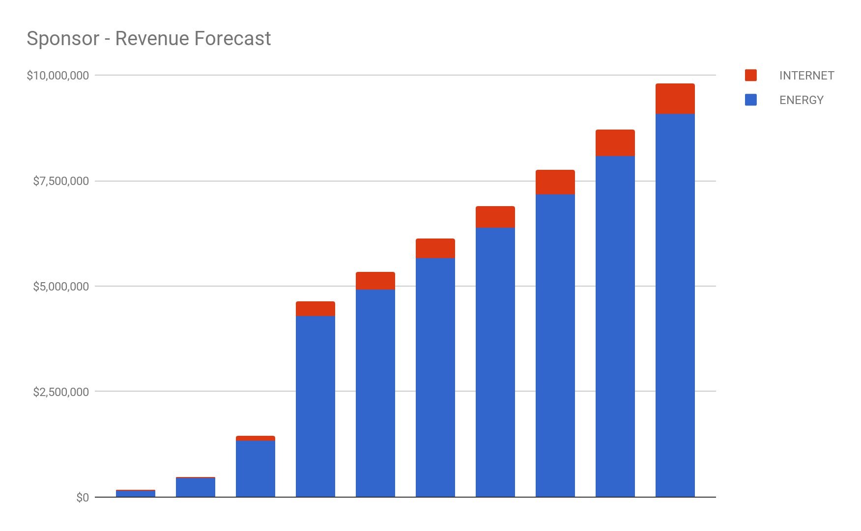
Financials
https://docs.google.com/spreadsheets/d/1SVmPE-pz5B5XTj3LIYsx0oXHJ9k1Oinw0kcBkNQwjoU/edit#gid=1872624015

Slide 14
www.globalivetechnology.com

Slide 16
Appendix

Slide 17
Abstract
Globalive Technology (GT) is pursuing development of a billing platform that will allow multi-service providers to issue a single bill to consumers which can be paid for with crypto.
This neatly aligns with GTP’s mission to develop software and hardware technology stacks with blockchain and machine learning that can improve the performance of existing operations or create new commercial opportunities and business models.
This document provides an analysis and product proposal based on the vision, research, and resources available to GTP and its partner parties.

Slide 18
Assumptions
We are open to in-house ventures we will lead that can make use of our existing investments, channel partners.
We are aware of the high cost of entry into the billing space given incumbent competitors and the scale of the business problems being solved by those players.
We are willing to facilitate professional services work for early-phase customers who will adopt the platform before we’ve reached the market share strong enough to push that work off to third-parties

Slide 19
Key Partners
Sponsor Energy is a energy and gas service provider in Calgary, Alberta which has gained traction in the deregulated market by offering 50% of its profits on provider a consumer’s energy to the charity of her choice.
Coinsquare is Canada’s largest cryptocurrency exchange. Unlike other trading platforms that require changing Canadian Dollars into foreign currency first, Coinsquare's QuickTrade instantly makes trades between any two currencies, whether it's CAD to Bitcoin or Ethereum to Litecoin.

Slide 20
Problem Space

Slide 21
Observed Problems
While companies like Zuora have succeeded at creating a modern billing system for SaaS companies that is easy to administer and cost effective to operate, there exist few equally-capable systems for utility and multi-service operators.

Slide 22
Observed Problems
Many utility and multi-service providers have disparate billing systems or legacy systems that are expensive to operate and inhibit or outright prevent broadening the providers’ service portfolio.

Slide 23
Observed Problems
Consumer engagement with service providers in the telecomm and utility space has plummeted with the rise of customer-centric tech companies. This lack of engagement stems from outdated, clunky, and friction-full customer journeys that inhibit administration, cross-selling, and more.

Slide 24
Perceived Opportunities
The utility sector (gas, electricity, etc.), particularly in deregulated markets, has a number of potential, looming blockchain applications that have tremendous potential, including but not limited to facilitating the disintermediation of energy delivery through smart metering and distributed energy sharing.

Slide 25
Perceived Opportunities
While cryptocurrency payment is still nascent, there exists the opportunity to leverage off-the-shelf technology like BitPay to facilitate crypto transactions as a part of a broader consumer brand play

Slide 26
Problem Statement
Multi-service operators face crisis. Consumers are spending more than ever with the providers of modern tech, but they’ve become largely disinterested in forming a relationship with, or buying from, MSOs.
MSOs are struggling to expand horizontally while consumers grow increasingly frustrated with the lackluster user experiences that the MSOs’ outdated infrastructure can empower.
As the energy market heads further towards disintermediation, off-grid self storage, and energy sharing, MSOs must adapt and evolve or risk becoming small-market players.

Slide 27
Customers

Slide 28
Personas
Digital Consumers
Multi-Service Operators
The Digital Consumer has built deeper relationships with the company making his cell phone than with the company providing his energy and services. He’s unaware of or actively disinterested in his MSOs.
Multi-service operators are both trying to horizontally expand and struggling to attract consumer interest. Whatever can attract, entice, and retain customers without killing margin wins.

Slide 29
Personas
Digital Consumers
Multi-Service Operators
Pays for utility as part of rental or owned property regularly
Not actively engaged with or aware of utility services
Has a legacy billing system
Trying to expand service offering horizontally to increase billings
Struggling to engage consumers and cross-sell

Slide 30
Personas
Digital Consumers
Multi-Service Operators
$X
Utility spending, annually
$Y
Telecom spend, annually
~$XK
Processing fees, annually
~$XK
Billing fee licensing
https://www.statista.com/statistics/247455/annual-us-consumer-expenditures/
http://www.businessinsider.com/restaurant-sales-slowdown-reasons-2017-7
http://aaronallen.com/blog/restaurant-marketing/restaurant-marketing-plan
https://vtldesign.com/digital-marketing/

Slide 31
Market

Slide 32
Market Sizing
$100B
(Subscription tools market by 2020)
$61B
(Utility CIS market by 2027)
https://www.zuora.com/press-release/new-report-reveals-subscription-economy-tools-market-reaching-100-billion-through-2020/
https://www.navigantresearch.com/newsroom/the-global-market-for-utility-customer-information-and-relationship-management-systems-is-expected-to-total-61-1-billion-over-the-next-decade
http://www.marchmenthill.com/qsi-online/2012-11-01/smarter-systems-procurement-understanding-cis-billing-systems-market-gives-water-businesses-investment-head-start/

Slide 33
Market Trends
https://www.opexengine.com/zuora-powering-the-subscription-revenue-economy-with-43-ipo-based-on-operating-metrics/ https://www.greentechmedia.com/articles/read/seven-charts-that-show-utility-priorities-for-2015-and-beyond

Slide 34
Market Trends
https://www.opexengine.com/zuora-powering-the-subscription-revenue-economy-with-43-ipo-based-on-operating-metrics/ https://www.greentechmedia.com/articles/read/seven-charts-that-show-utility-priorities-for-2015-and-beyond

Slide 35
Competitive Landscape

Slide 36
Competition
Generic
Customer Information System
Billing
Sector-Specific

Slide 37
Incumbents (Traditional)
Utility Billing
Gentrack
Grange
Harris
Cayenta
Northstar
Comverse
Hansen Technologies
eFluid SAS
Fluentgrid Limited
Itineris
Open International Systems
Waterworks LMS
Generic Billing
Oracle
SAP
Zuora
NetSuite
Dynamics
OSS/BSS Billing
Amdocs
Logisense
OpenBilling System

Slide 38
Emergents
Utility Billing
CUSI
Utilibill
Hydra Billing
Fusebill
Chargebee
OSS/BSS Billing
Commsoft
Cadebill
OneBill
Generic Billing
Recurly
Chargify
Zoho
FreshBooks
Stripe

Slide 39
Adjacents
Accounting
Quickbooks
Xero
Wave
Sage Business
Zoho
FreshBooks
CRM
SalesForce
Zoho
Insightly
Freshworks
Pipedrive
Help Desk
Desk.com
ZenDesk
FreshDesk
Zoho

Slide 40
Competitor Spotlight

Slide 41
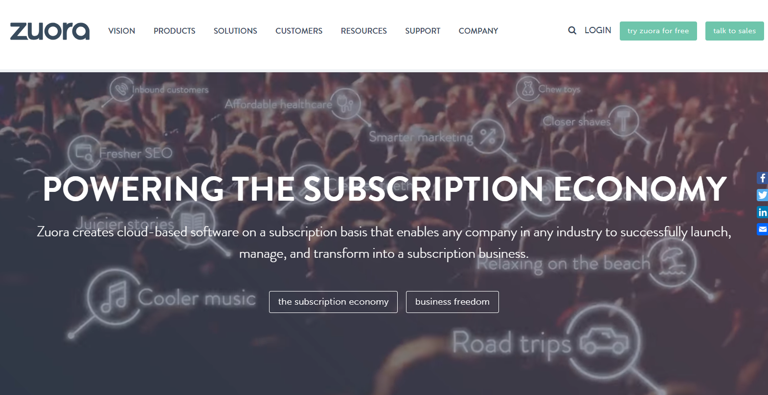
Zuora

Slide 42
Overview
Zuora provides the leading modern subscription management and billing platform, with over $250M in ARR and a recent IPO putting it at a $2B
The Zuora platform allows businesses like Box, HBO, Sage, and more to easily configure and issue subscription bills in various models including tiered and usage-based
The platform was original built by former SalesForce executives and leverages the SalesForce AppExchange channel significantly

Slide 43
Solution

Slide 44
Solution Vision
GT Bill is the only consumer-first business operations platform.
Multi-service operators that use GT Bill can provide consumers with a seamless and cohesive experience for sales, billing, support, and consumption of their services.
No more clunky legacy systems and janky user experiences; just one portal, one bill, and one relationship.

Slide 45
Strategic Fit
Flexiti
JVs
Multi-service Commerce
Crypto Payments
Smart Energy Trading
Tech
Blockchain
IoT
Notes:
Flexiti JV
FutureVault JV
Coinsquare JV?
Coinsquare Wallet
Blockchain angle / how does this fit our tech mandate?
Mid-term: Loyalty against purchase history
Long-term: Purchase asset on the asset chain to facilitate safe auction experiences

Slide 46
Business Model

Slide 47
Business Model
Short-term Revenue Opportunities
Initial development costs via Sponsor
Rev share on bills issued
Mid-term Revenue Opportunities
Licensing to Pulse Energy, other customers
Rev share on bills issued
Long-term Opportunities
SaaS licensing revenue from adjacent industries
Rev share on bills issued to adjacent industry consumers

Slide 48
Fixed Costs
Infrastructure Start-up Costs
Cloud back-end (commerce API platform, etc.)
Dev hardware, etc.
Initial Build-out Staffing
In-house product development team
1x front-end dev
2x back-end infrastructure dev(s)
1x integration specialist
1x dev ops
1x enterprise app designer
Brand development

Slide 49
Variable Costs
Application Hosting
Cloud back-end (AI, ingestion engine)
Storage
Compute
Interac, Coinsquare transaction feeds
Ongoing Staffing
In-house product development team
In-house sales, marketing, ops, support, legal teams?
Demand Generation
Customer acquisition costs (e.g., prospecting, direct sales)
Conference attendance (e.g., utilitycon)

Slide 50
Financials
https://docs.google.com/spreadsheets/d/1SVmPE-pz5B5XTj3LIYsx0oXHJ9k1Oinw0kcBkNQwjoU/edit#gid=1872624015

Slide 51
Product

Slide 52
Overview
The GT Bill platform will provide multi-service with a robust and highly-configurable billing system
lightweight easy to implement consolidated billing solution for resell providers of aggregated services
The platform will facilitate seamless integrations with other critical business software to empower multi-service operator agility
API platform connectivity to…
MailChimp
SalesForce
Docusign
ZenDesk
etc.

Slide 53
Our Product
GT Bill
GT Provision
Customer Management
Products & Pricing
APIs
Data Transformer
GT Bill Dev Platform
Customer Portal
Invoicing
Bidirectional Provisioning
Contracts & Token Accounting
Payments
Notes:
Project “GT Wallet” will allow consumers to use (digital) fiat currency, cryptocurrency, or on-demand financing to pay at restaurant or retail locations while earning incentives from those venues to return.
GT Wallet will allow retailers and restaurateurs to accept crypto and receive fiat while enjoying lower processing fees and a low-cost increase in demand driven through the integrated loyalty program.
The GT Wallet will be app #1 for the “GT Commerce Cloud” platform, which will facilitate expansion into adjacent e-commerce and payment spaces, including P2P payments, auctioning, and more in the future.

Slide 54
Roadmap
Basic customer management
Basic customer portal
Admin interface
Invoicing
Reporting
Provisioning
Charity Management
Product and pricing configuration
Payments
Token Issuance
Promotions

Slide 55
Initial Go To Market
GT Bill will initially launch with Sponsor Energy
Reseller of electricity and gas utilities in Alberta and expanding to resell Internet and Home Phone services
Looking to replace its existing billing system by Dec 31
Sponsor will help to push the GT Bill product into a second customer
Sponsor will continue to act as a reseller and benefit from doing so through the joint venture

Slide 56
Build Plan

Slide 57
Phase 0
Validation & Infrastructure

Slide 58
Phase 0
Initial user experience will be fully mapped out and validated with Sponsor.
Light user testing with channel partner customers
Core web platform scaffolding will be stood up by dev lead.
Architecture and sequence diagrams for integration with Alta Gas will be fleshed out.
Alta Gas agreements signed
Core integration work will be defined and sized

Slide 59
Phase 1
Consumer MVP

Slide 60
Phase 1
First production product will include customer registration and management.
Will need to build out infrastructure for CRM
Will include the build out for both the admin portal, the client portal, and the token infrastructure for accounting consumption of services.
Invoicing will follow in to drive towards “first bill”
During intial POC work, the teams will need to do some manual work to create bills (e.g., no usage data at first).
Rapid iteration of initial user experience in-market
Extensive user and customer research to iterate on core design
Additional infrastructure work to support future features

Slide 61
Phase 1
Token issuance and accounting will be baked into this phase
Each customer will be issued a certain amount of tokens per month, pegged to the local currency (e.g., CAD). This amount represents the “idealized” consumption.
At the end of the month, the customers’ owing balance will be deducted first from tokens and then issued as a normal bill in fiat
Leftover tokens carryover and can be traded freely with other members of the network (with no oversight or transaction fees from Sponsor). In the future, tokens will be “mined” independently by individuals who are storing energy on prem. That energy can then be sold to other members for tokens.
This infrastructure will allow us to pre-position us for the decentralized energy sharing of tomorrow

Slide 62
Phase 2
Platform Maturation

Slide 63
Phase 2
Additional features will begin to be layered in iteratively
Payments
Promotions
Charity Management
Provisioning development will proceed
Will work through this with a dedicated developer who will liase with Alta Gas development team
Map out “Wave 2” features
Begin “Phase 0” deep dive design process for bigger forward-looking features like smart metering and energy swap on the blockchain, ML against the energy consumption data, etc.

Slide 64
Coordination
Team structure, ownership areas, and responsibilities.

Slide 65
Team
Business Plan
RA
CI
Product Strategy
RACI
I
GT Bill
RAC
I
GT Provision
RAC
AC
Alta Gas
CI
RA
Sales
CI
RA
Demand Gen
CI
RA
Licensing
RA
CI

Slide 66
Go To Market

Slide 67
Launch Strategy
Target Alberta Energy Sector first
Use existing channel partners to drive adoption (e.g., Sponsor)
Deal with regulatory and infrastructure issues on our home turf
Move to the NZ with Pulse
Leverage the Sponsor relationship to add additional customers
Look to expand to new channel partners in the US (California)
Expand to Other Sectors
Once GT Bill is up and running, we will be able to leverage our relationship with Sponsor and other Globalive family members to find new business.

Slide 68
Demand Generation Strategy
While there will need to be a complete top-to-bottom marketing strategy defined once the product vision is crystallized, there are some immediate considerations:
How are we going to attract prospects to drive adoption?
How are we going to do our own demand generation outside of Sponsor?
No matter what approach we take, we need to think about what the initial go to market will look like
How will we pull the veil off?
Who can we co-market with to make this something big)

Slide 69
Unknowns

Slide 70
Open Concerns
Alta Gas. Lulz.

Slide 71
Risks
Ensuring that we have channel commitment from Sponsor as we have a PoC come online will be critical
Ensuring that the Alta Gas provisioning work is contained so as to not explode scope is a key concern

Slide 72
Next Steps

Slide 73
Let’s Discuss
How do we get to sizing and timing?
Break down roadmap into project plans
Size w/ Swapan
More aggressively pursue hiring for the team
Who owns moving the biz relationships forward?
Sponsor
Alta Gas
Customer #2

Slide 74
www.globalivetechnology.com

